Slide 1

DS501 Case Study1- Team 6
How can Netflix make profit ? --- Data analysis on Iron Fist Trailer-related tweets
Target Customer: Netflix
Team Members
Bagul, Aashish
Xu, Qian
Sun,Fangzheng
Liu,Huanhan

Slide 2

Marvel Iron Fist

Slide 3


Slide 4


Slide 5


Slide 6
What is your expectation?

Slide 7


Slide 8
What do people care most in TV series?
People really love their fantastical dramas and wants them to become real.
Statistics shows that shows ended like M*A*S*H* drew 105.8m viewers in America in 2005
Statistics show around 73% of Americans watch superhero TV series
Some of the famous are Flash, Daredevil, Jessica Jones.

Slide 9
Twitter Data will help you understand
What people actually think about the show
What are the expectations of people?
What are the things TV series makers should keep in mind before making the show releases.
What are regions they should focus on to promote their show

Slide 10
Data Gathering
Twitter streaming API was used to collect tweets based on key words.
A total of 1188 tweets were obtained and stored in a JSON file.
Key Words
“ #ironfist”, “#IronFist”, “IronFist Trailer”,”FinnJones”,”CollenWing”

Slide 11




Analysis Method
Data
Collection
Data
Storage
Data
Analysis
Data
Visualization

Slide 12
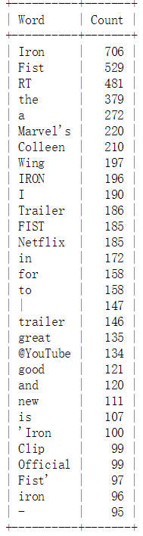
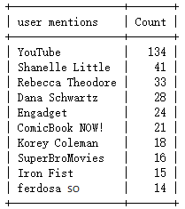
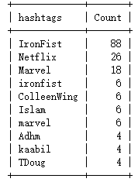
Data Analysis (keywords)
Youtube
Fist
Marvel
Iron
Great
Good
Trailer
Netflix

Slide 13
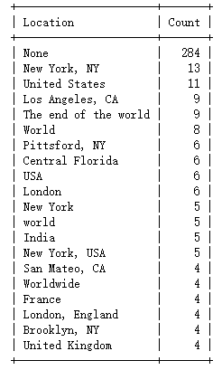
Data Analysis (Regions)
Pittsford
New York
California
United Kingdom
Central Florida

Slide 14
How would Netflix learn from our data to Attract more audience all over the US?
By having a regional analysis Netflix can target certain region where the show is not so popular.
They can start promoting the show in the region where it is not popular.
They can take into consideration their profit center regions and make their episodes on the basis of what people like to see in the show.
By giving certain episodes free to watch in the regions where it is not so popular can help them increase the popularity of that region.

Slide 15
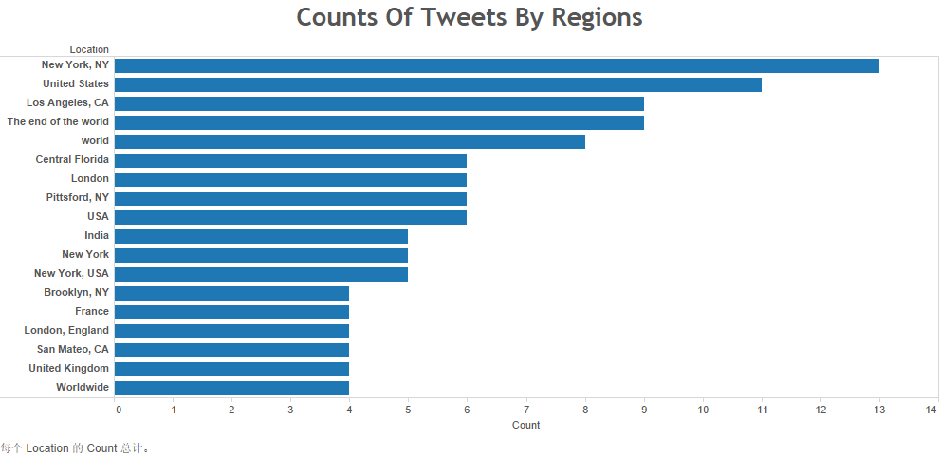

Slide 16
Conclusion
•Twitter Data shows that Netflix should spend more resources in major states like Washington, Texas, Wisconsin, Ohio .
•By keeping an eye on how the trends evolve Netflix can change its tactics and focus some more states.
•They should also pay attention to what according to audience is bad about the trailer and try to improve it.

Slide 17
Data Limitation
Sample Size Limitation
2.Representative Limitation
3.Time Limitation

Slide 18
Q & A

Slide 19
Thank you!

